Slide 1
PRICING
Pricing is the method of determining the value a producer will get in the exchange of goods and services.

Slide 2
Pricing Objectives
Company’s Pricing policies and strategies are aimed at fulfilling the following objectives:
Sales Maximization
Profits Maximization
Customer satisfaction
To meet the Competition
To Capture a better Market Share

Slide 3
Pricing Methods
An Organization will have various options for selecting a Pricing Method.
Price given to a product is usually based on 3 dimensions that are Cost, Demand & Competition.
The Organization can use any one of the above mentioned dimensions or combination of them to set the price of a product.

Slide 4
Categories
Pricing methods are presented in four categories
I. Cost based pricing methods
Competition based pricing methods
Demand based pricing methods
Strategy based pricing methods

Slide 5
I. Cost based Pricing Category
We have two methods in this category:
Cost plus Pricing method: in this method price of the product is the combination of two variables.
Price = Total Cost + Profit Margin (P=TC+PM)
Total cost is determined and then a target profit margin is applied or added to it.
Ex: If a product costs Rs. 10 to manufacture and the firm wants to make a 20% profit, the price is Rs. 12 per unit.

Slide 6
2. Marginal Cost Pricing Method
In this method we don’t look for individual profit margins.
Price of the product is fixed in such a way that it covers entire amount of variable cost and either partial or full amount of fixed cost depending upon the situation.
Selling at a price that is above the marginal cost but below the total cost.
Marginal pricing is based on the assumption that since fixed and variable costs are covered by the current output level, the cost of producing any extra unit (Marginal Output) will comprise only of variable costs.

Slide 7
II. Competition based Pricing Category/Methods
We have two methods in this category
Sealed Bid Pricing Method: this method if followed while inviting tenders, contracts, auctions etc.
Competing firms will be submitting their bids in a sealed cover to the concern authority. Who ever quotes the lowest possible bid will be having high probability of winning the contract or tender etc.

Slide 8
2. Going rate pricing method
Setting a price for a product or service using the prevailing market price as a basis.
We simply follow the current market price and give exactly the same price for our products.

Slide 9
III. Demand Based Pricing Category/Methods
We have two methods even in this category.
Price Discrimination: is also called as Differential Pricing Method, in this there is a practice of charging a different price for the same good or service.
The term differential pricing is also used to describe the practice of charging different prices to different buyers for the same quality and quantity of a product.
It is all about different people paying different prices for the same product/service.

Slide 10
2. Perceived Pricing Method
In this method the valuation of good or service is according to how much consumers are willing to pay for it, rather than upon its production and delivery costs.
This pricing technique might be somewhat arbitrary, but it can greatly assist the companies in the effective marketing of a product since it sets product pricing in line with the perception of its potential buyers.

Slide 11
IV. Strategy Based Pricing Category/Methods
Market Skimming:
In most skimming, goods are sold at higher prices so that the firm can quickly get back the investment cost.
This strategy is commonly used in electronic markets.
This is often used to target ‘Early Adopters’ of a product or service. Early adopters generally have a relatively lower price-sensitivity- this can be attributed to: their need for the product outweighing their need to economise - a greater understanding of the product’s value or simply having a higher disposable income.

Slide 12
2. Market Penetration
A Penetration pricing strategy is designed to capture market share by entering the market with a low price to attract buyers.
The idea is that the business will be able to raise awareness and get people to try the product, and to maximise the sales.

Slide 13
3. Two-Part Pricing
In this method, firm will be charging twice, buyer will have to pay twice exactly for the same product/service.
In this method, a fixed charge that does not vary with usage or consumption and an additional charge that keeps varying along with usage will be levied.
Ex: Providers of services including Banking and finance, telecommunications commonly apply Two-part pricing.

Slide 14
4. Block Pricing
In this method, two or more units of the same product will be collectively offered in a single package.
This method benefits both the buyers as well as makers.
Makers will be able to maximize their sales through this strategy and sellers will be subjected to a small discount.
Ex: pears soaps, santoor soaps etc

Slide 15
5. Bundled Pricing
The act of placing several products or services together in a single package and selling for a lower price than would be charged if the items were sold separately.
The package usually includes one big ticket product and at least one complementary good.
Ex: value meals at restaurants, cable TV channel plans, holiday package etc.

Slide 16
6. Transfer Pricing
Transfer pricing is the value which is attached to the goods or services transferred between related parties.
Transfer pricing happens whenever two companies that are part of the same multinational group, trade with each other: when a US-based subsidiary of Coca-Cola, for example, buys something from a French-based subsidiary of Coca-Cola. When the parties establish a price for the transaction, this is transfer pricing.
it is the price which is paid for goods or services transferred from one unit of an organization to its other units situated in different geographical areas.

Slide 17
Pricing strategies in times of stiff price competition
Price Matching
Promoting brand loyalty
Time-to-time pricing
Promotional pricing
Target pricing

Slide 18
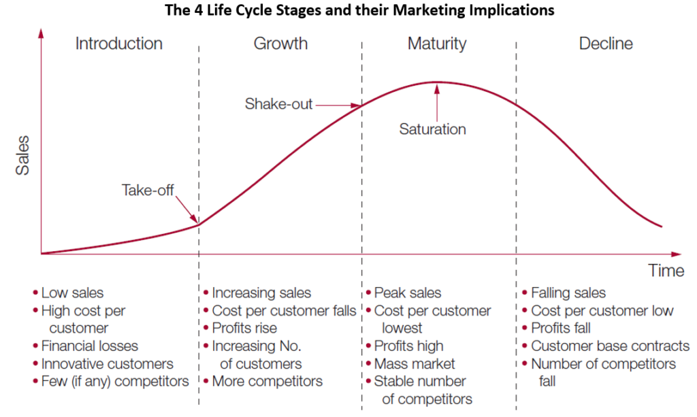
Product Life Cycle based Pricing

Slide 19
PLC based Pricing Strategies:
Introductory Stage:
Market Skimming
Market Penetration
Growth Stage:
Competitive pricing strategy
Maturity Stage:
Discount pricing strategy
Decline Stage:
Discount pricing strategy
Bundling

